Slide 1
Logistic Regression

Slide 2
Introduction
Logistic regression is a supervised machine learning algorithm used for classification problems, most commonly binary classification (e.g., spam vs. not spam, diseased vs. healthy).

Slide 3
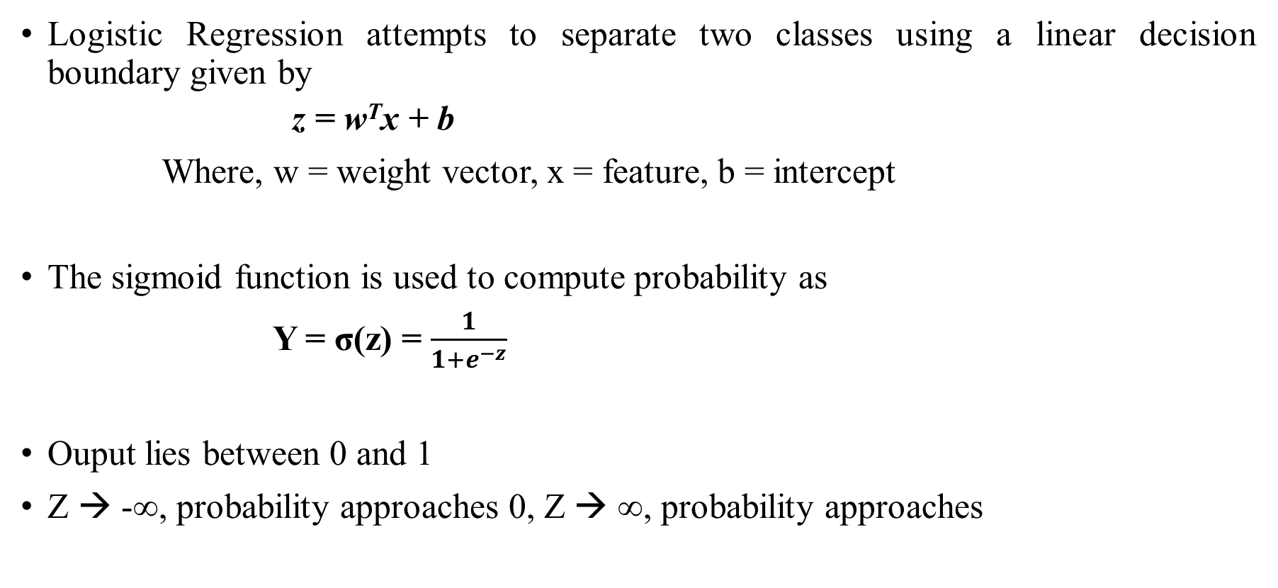
Logistic Regression Model
Logistic Regression attempts to separate two classes using a linear decision boundary given by
    z = w^{T}x + b
Where, w = weight vector, x = feature, b = intercept
The sigmoid function is used to compute probability as
Y = σ(z) = $\frac{1}{1+e^{−z}}$
Ouput lies between 0 and 1
Z → -∞, probability approaches 0, Z → ∞, probability approaches

Slide 4
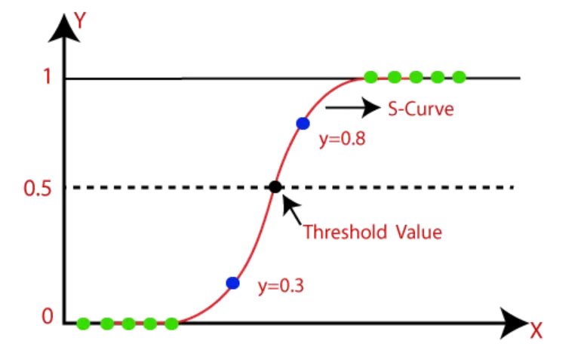
S-shaped curve
Probability
Feature

Slide 5

Decision Threshold
An observation is classified as follows: -
  Class 1 if $P\left(Y=1∣X\right)≥0.5$
  Class 0 if P(Y = 1∣ X ) < 0.5
The boundary between the two classes occurs when:
P(Y = 1 ∣ X ) = 0.5

Slide 6

Decision Boundary
$$\frac{1}{1+e^{−z}}=0.5$$
$$1+e^{−z}=2$$
$$e^{−z}=1$$
Taking log on both sides
Z = 0
Since z = w^{T}x + b
The decision boundary is w^{T}x + b = 0

Slide 7
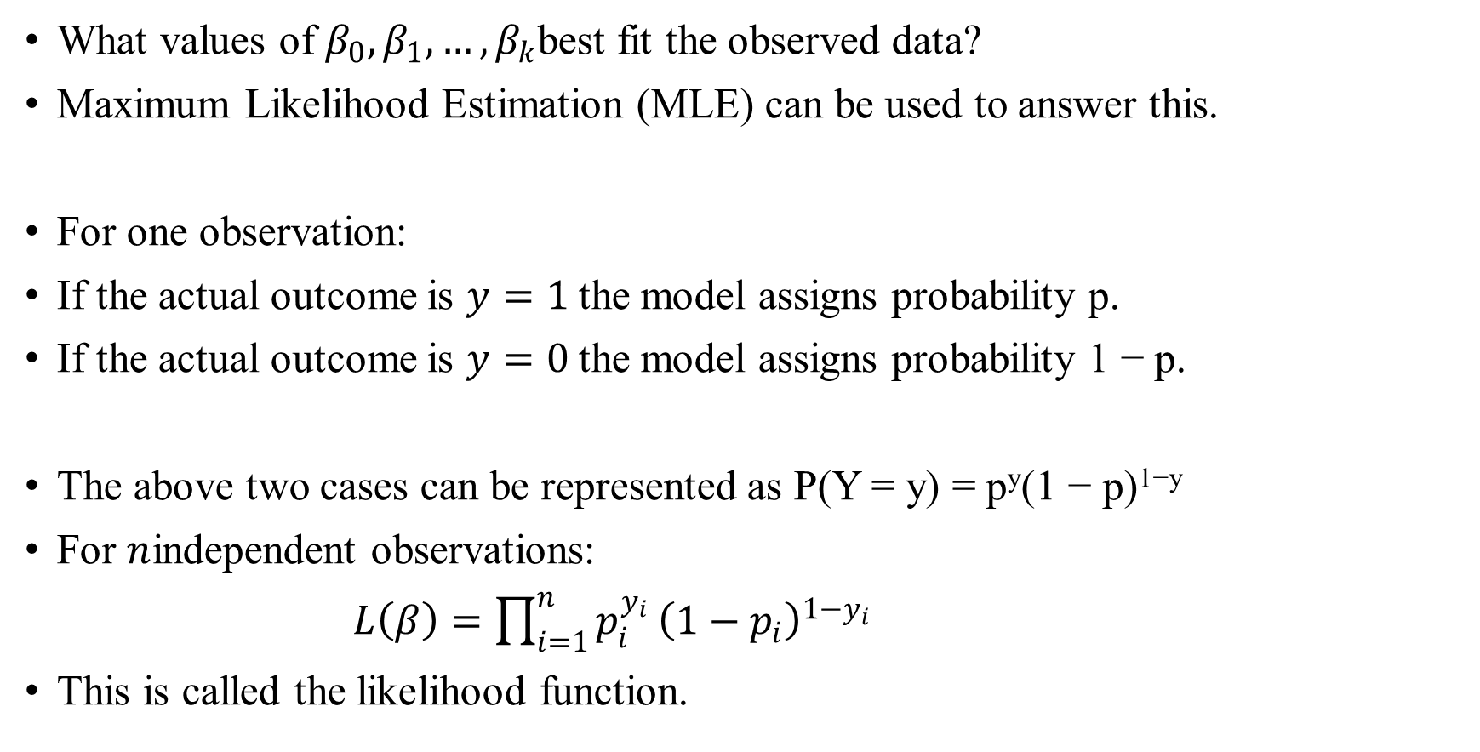
How are the coefficients chosen?
What values of $β_{0},β_{1},…,β_{k}$best fit the observed data?
Maximum Likelihood Estimation (MLE) can be used to answer this.
For one observation:
If the actual outcome is $y=1$the model assigns probability p.
If the actual outcome is $y=0$the model assigns probability 1 − p.
The above two cases can be represented as P(Y = y) = p^{y}(1 − p)^{1−y}
For $n$independent observations:
$L\left(β\right)=\prod_{i=1}^{n}{p_{i}^{y_{i}}}{\left(1−p_{i}\right)}^{1−y_{i}}$
This is called the likelihood function.

Slide 8
Maximum Likelihood Estimation
MLE chooses coefficient values that maximize L(β). In other words find the coefficients that make the observed data most probable.

Slide 9
References
https://towardsdatascience.com/logistic-regression-in-python-2f965c355b93/

